Slide 1
Malloc Recitation
Ben Spinelli
Recitation 11: November 9, 2015

Slide 2
Agenda
Macros / Inline functions
Quick pointer review
Malloc

Slide 3
Macros / Inline Functions

Slide 4
Macros
Pre-compile time
Define constants:
#define NUM_ENTRIES 100
OK
Define simple operations:
#define twice(x) 2*x
Not OK
twice(x+1) becomes 2*x+1
#define twice(x) (2*(x))
OK
Always wrap in parentheses; it’s a naive search-and-replace!

Slide 5
Macros
Why macros?
“Faster” than function calls
Why?
For malloc
Quick access to header information (payload size, valid)
Drawbacks
Less expressive than functions
Arguments are not typechecked, local variables
This can easily lead to errors that are more difficult to find

Slide 6
Inline Functions
What’s the keyword inline do?
At compile-time replaces “function calls” with code
More efficient than a normal function call
Less overhead – no need to set up stack/function call
Useful for functions that are
Called frequently
Small, e.g., int add(int x, int y);

Slide 7
Differences
Macros done at pre-compile time
Inline functions done at compile time
Stronger type checking / Argument consistency
Macros cannot return anything (why not?)
Macros can have unintended side effects
#define xsquared(x) (x*x)
What happens when xsquared(x++) is called?
Hard to debug macros – errors generated on expanded code, not code that you typed

Slide 8
Macros / Inline Functions
You will likely use both in malloc lab
Macros are good for small tasks
Saves work in retyping tedious calculations
Can make code easier to understand
HEADER(ptr) versus doing the pointer arithmetic
Some things are hard to code in macros, so this is where inline functions come into play
More efficient than normal function call
More expressive than macros

Slide 9
Pointers: casting, arithmetic, and dereferencing

Slide 10
Pointer casting
Cast from
<type_a>* to <type_b>*
Gives back the same value
Changes the behavior that will happen when dereferenced
<type_a>* to integer/ unsigned int
Pointers are really just 8-byte numbers
Taking advantage of this is an important part of malloc lab
Be careful, though, as this can easily lead to errors
integer/ unsigned int to <type_a>*

Slide 11
Pointer arithmetic
The expression ptr + a doesn’t mean the same thing as it would if ptr were an integer.
Example: type_a* pointer = …; (void *) pointer2 = (void *) (pointer + a);
This is really computing:
pointer2 = pointer + (a * sizeof(type_a))
lea (pointer, a, sizeof(type_a)), pointer2;
Pointer arithmetic on void* is undefined

Slide 12
Pointer arithmetic
int * ptr = (int *)0x12341230; int * ptr2 = ptr + 1;
char * ptr = (char *)0x12341230; char * ptr2 = ptr + 1;
int * ptr = (int *)0x12341230; int * ptr2 = ((int *) (((char *) ptr) + 1));
char * ptr = (char *)0x12341230; void * ptr2 = ptr + 1;
char * ptr = (int *)0x12341230; void * ptr2 = ptr + 1;

Slide 13
Pointer arithmetic
int * ptr = (int *)0x12341230; int * ptr2 = ptr + 1; //ptr2 is 0x12341234
char * ptr = (char *)0x12341230; char * ptr2 = ptr + 1; //ptr2 is 0x12341231
int * ptr = (int *)0x12341230; int * ptr2 = ((int *) (((char *) ptr) + 1)); //ptr2 is 0x12341231
char * ptr = (char *)0x12341230; void * ptr2 = ptr + 1; //ptr2 is 0x12341231
char * ptr = (int *)0x12341230; void * ptr2 = ptr + 1; //ptr2 is still 0x12341231

Slide 14
More pointer arithmetic
int ** ptr = (int **)0x12341230; int * ptr2 = (int *) (ptr + 1);
char ** ptr = (char **)0x12341230; short * ptr2 = (short *) (ptr + 1);
int * ptr = (int *)0x12341230; void * ptr2 = &ptr + 1;
int * ptr = (int *)0x12341230; void * ptr2 = ((void *) (*ptr + 1));
This is on a 64-bit machine!

Slide 15
More pointer arithmetic
int ** ptr = (int **)0x12341230; int * ptr2 = (int *) (ptr + 1); //ptr2 = 0x12341238
char ** ptr = (char **)0x12341230; short * ptr2 = (short *) (ptr + 1); //ptr2 = 0x12341238
int * ptr = (int *)0x12341230; void * ptr2 = &ptr + 1;//ptr2 = ?? //ptr2 is actually 8 bytes higher than the address of the variable ptr, which is somewhere on the stack
int * ptr = (int *)0x12341230; void * ptr2 = ((void *) (*ptr + 1)); //ptr2 = ?? //ptr2 is one plus the value at 0x12341230
(so undefined, but it probably segfaults)

Slide 16
Pointer dereferencing
Basics
It must be a POINTER type (or cast to one) at the time of dereference
Cannot dereference expressions with type void*
Dereferencing a t* evaluates to a value with type t

Slide 17
Pointer dereferencing
What gets “returned?”
int * ptr1 = malloc(sizeof(int)); *ptr1 = 0xdeadbeef;
int val1 = *ptr1;
int val2 = (int) *((char *) ptr1);
What are val1 and val2?

Slide 18
Pointer dereferencing
What gets “returned?”
int * ptr1 = malloc(sizeof(int)); *ptr1 = 0xdeadbeef;
int val1 = *ptr1;
int val2 = (int) *((char *) ptr1);
// val1 = 0xdeadbeef;
// val2 = 0xffffffef;
What happened??

Slide 19
Malloc

Slide 20
Malloc basics
What is dynamic memory allocation?
Terms you will need to know
malloc/ calloc / realloc
free
sbrk
payload
fragmentation (internal vs. external)
coalescing
Bi-directional
Immediate vs. Deferred

Slide 21
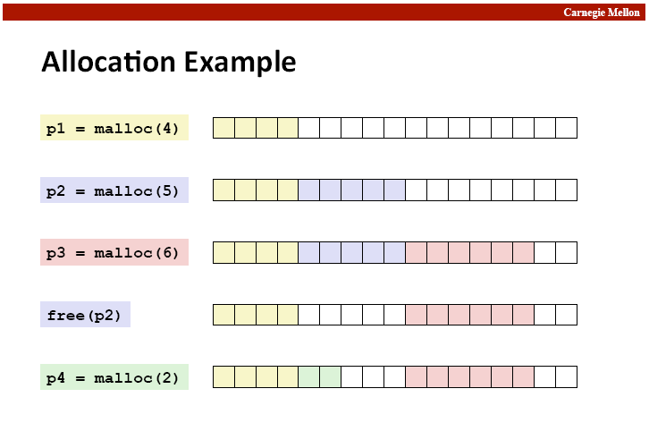

Slide 22
Fragmentation
Internal fragmentation
Result of payload being smaller than block size.
void * m1 = malloc(3); void * m1 = malloc(3);
m1,m2 both have to be aligned to 8 bytes…
External fragmentation

Slide 23
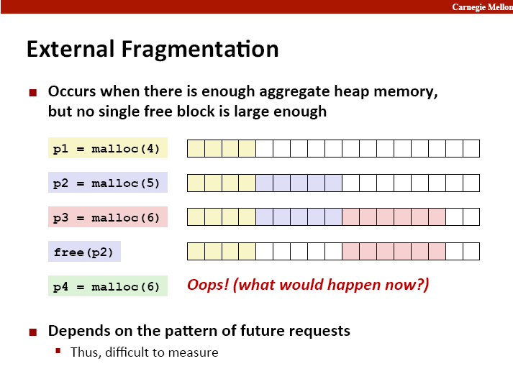

Slide 24
Implementation Hurdles
How do we know where the blocks are?
How do we know how big the blocks are?
How do we know which blocks are free?
Remember: can’t buffer calls to malloc and free… must deal with them real-time.
Remember: calls to free only takes a pointer, not a pointer and a size.
Solution: Need a data structure to store information on the “blocks”
Where do I keep this data structure?
We can’t allocate a space for it, that’s what we are writing!

Slide 25
The data structure
Requirements:
The data structure needs to tell us where the blocks are, how big they are, and whether they’re free
We need to be able to CHANGE the data structure during calls to malloc and free
We need to be able to find the next free block that is “a good fit for” a given payload
We need to be able to quickly mark a block as free/allocated
We need to be able to detect when we’re out of blocks.
What do we do when we’re out of blocks?

Slide 26
The data structure
It would be convenient if it worked like:
malloc_struct malloc_data_structure;
… ptr = malloc(100, &malloc_data_structure);
…
free(ptr, &malloc_data_structure);
…
Instead all we have is the memory we’re giving out.
All of it doesn’t have to be payload! We can use some of that for our data structure.

Slide 27
The data structure
The data structure IS your memory!
A start:
<h1> <pl1> <h2> <pl2> <h3> <pl3>
What goes in the header?
That’s your job!
Lets say somebody calls free(p2), how can I coalesce?
Maybe you need a footer? Maybe not?

Slide 28
The data structure
Common types
Implicit List
Root -> block1 -> block2 -> block3 -> …
Explicit List
Root -> free block 1 -> free block 2 -> free block 3 -> …
Segregated List
Small-malloc root -> free small block 1 -> free small block 2 -> …
Medium-malloc root -> free medium block 1 -> …
Large-malloc root -> free block chunk1 -> …

Slide 29
Implicit List
From the root, can traverse across blocks using headers
Can find a free block this way
Can take a while to find a free block
How would you know when you have to call sbrk?

Slide 30
Explicit List
Improvement over implicit list
From a root, keep track of all free blocks in a (doubly) linked list
Remember a doubly linked list has pointers to next and previous
When malloc is called, can now find a free block quickly
What happens if the list is a bunch of small free blocks but we want a really big one?
How can we speed this up?

Slide 31
Segregated List
An optimization for explicit lists
Can be thought of as multiple explicit lists
What should we group by?
Grouped by size – let’s us quickly find a block of the size we want
What size/number of buckets should we use?
This is up to you to decide

Slide 32
Design Considerations
I found a chunk that fits the necessary payload… should I look for a better fit or not? (First fit vs. Best fit)
Splitting a free block:
void* ptr = malloc(200);
free(ptr);
ptr = malloc(50); //use same space, then “mark” remaining bytes as free
void* ptr = malloc(200);
free(ptr);
ptr = malloc(192);//use same space, then “mark” remaining bytes as free??

Slide 33
Design Considerations
Free blocks: address-ordered or LIFO
What’s the difference?
Pros and cons?
Coalescing
When do you coalesce?
You will need to be using an explicit list at minimum score points
But don’t try to go straight to your final design, build it up iteratively.

Slide 34
Heap Checker
Part of the assignment is writing a heap checker
This is here to help you.
Write the heap checker as you go, don’t think of it as something to do at the end
A good heap checker will make debugging much, much easier
Heap checker tips
Heap checker should run silently until it finds an error
Otherwise you will get more output than is useful
You might find it useful to add a “verbose” flag, however
Consider using a macro to turn the heap checker on and off
This way you don’t have to edit all of the places you call it
There is a built-in macro called __LINE__ that gets replaced with the line number it’s on
You can use this to make the heap checker tell you where it failed

Slide 35
Demo
Running Traces
Heap checker
Using gprof to profile

